Slide 1
Small Project 2 GAWAI STUDIO
Arizki

Slide 2

Membangun Infrastruktur Berbasis Cloud AWS

Slide 3
Processing
Desain Infrastruktur Server
Membuat Server Cloud Untuk Beban Traffic Tinggi
Membuat Storage Database
Memisah Database Server

Slide 4

TOPOLOGI INFRASTRUKTUR CLOUD

Slide 5
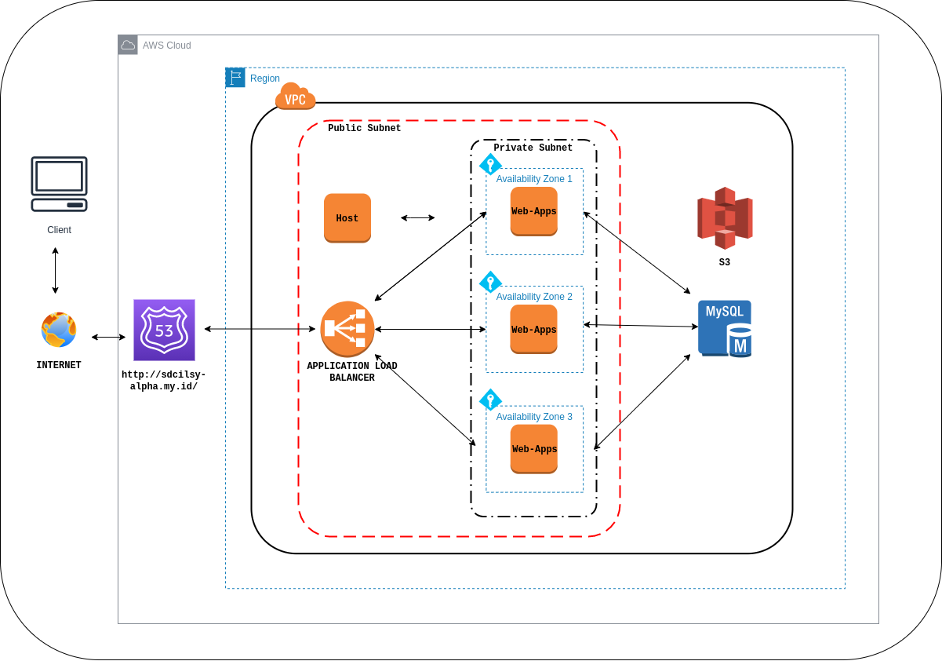
Topologi Insfrastruktur cloud

Slide 6
Budget Project Gawai Studio
BUDGET
No | Service | Spesifikasi | Monthly
1 | EC2 | Operating system (Linux) | 30,79 USD
 |  | Quantity (3)
 |  | Pricing strategy (EC2 Instance Savings Plans 1 Year No Upfront)
 |  | Storage amount (4 GB)
 |  | Instance type (t4g.small)
2 | RDS | Storage for each RDS instance (General Purpose SSD (gp2)) | 29,69 USD
 |  | Storage amount (30 GB)
 |  | Quantity (1)
 |  | Instance type (db.t1.micro)
 |  | Deployment option (Single-AZ)
 |  | Pricing strategy (OnDemand)"
3 | ELASTIC LOAD BALACING | Number of Classic Load Balancers (3) | 61,34 USD
 |  | Processed bytes per CLB (1 GB per month)
4 | AMAZON ROUTE 53 | Hosted Zones (1) | 0,50 USD
 |  | First 12 months total | 1,467.84 USD
 |  | Total monthly | 122.32 USD

Slide 7
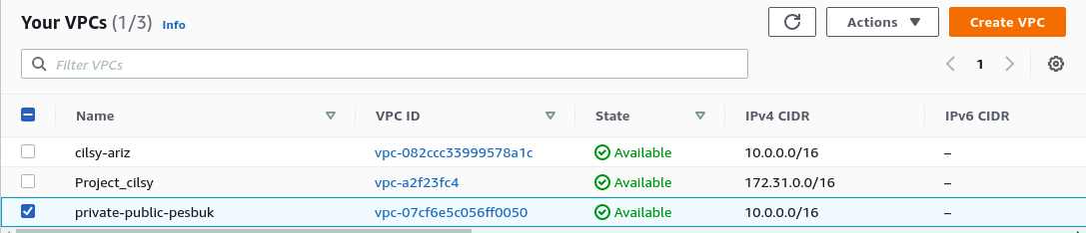
Virtual Private Cloud

Slide 8
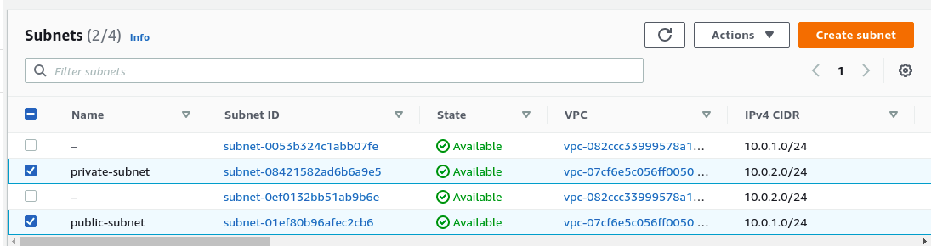
Subnet

Slide 9
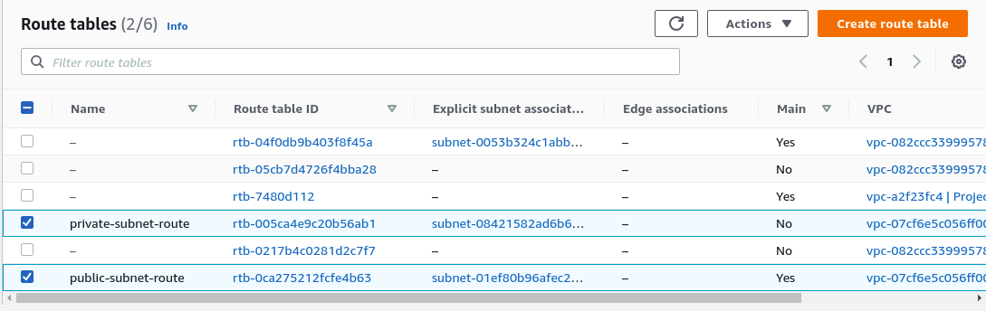
Route Table

Slide 10
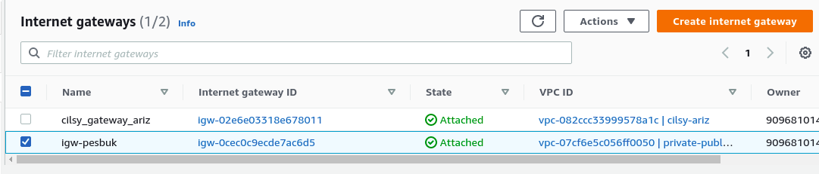
Internet Gateway

Slide 11
BUCKET

Slide 12
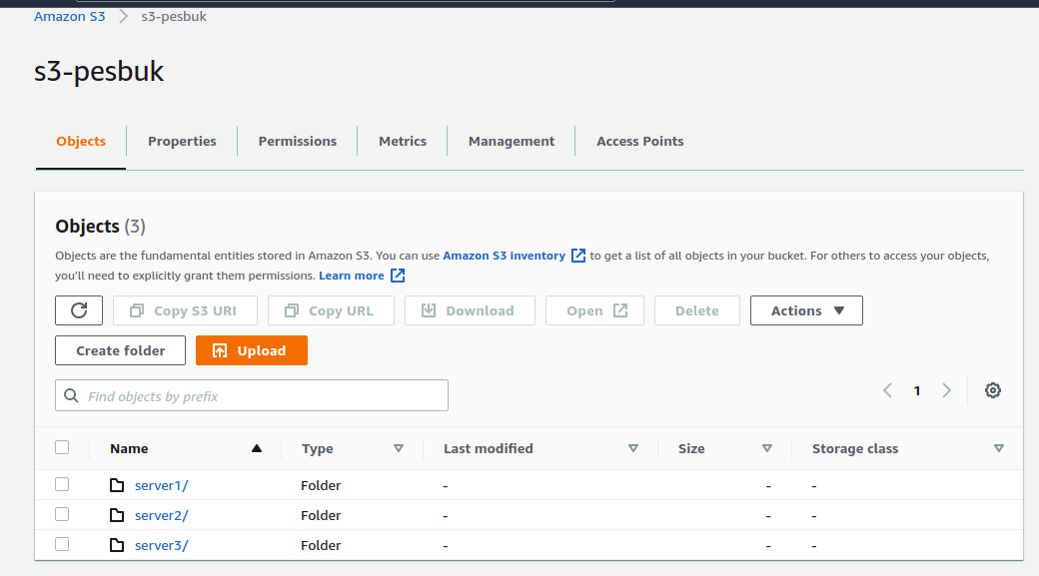
Amazon S3

Slide 13
INSTANCE

Slide 14
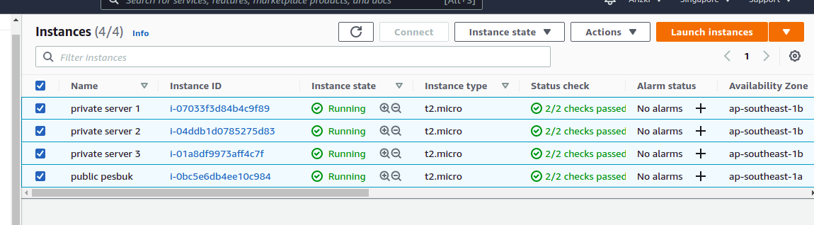
Instance

Slide 15
AMAZON RDS

Slide 16
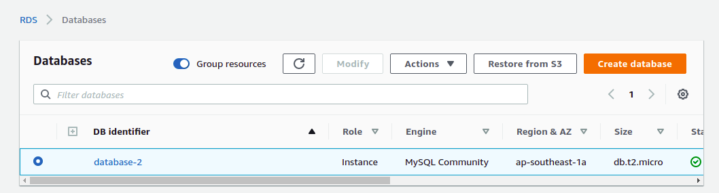
RDS Mysql

Slide 17
MOUNTING S3

Slide 18
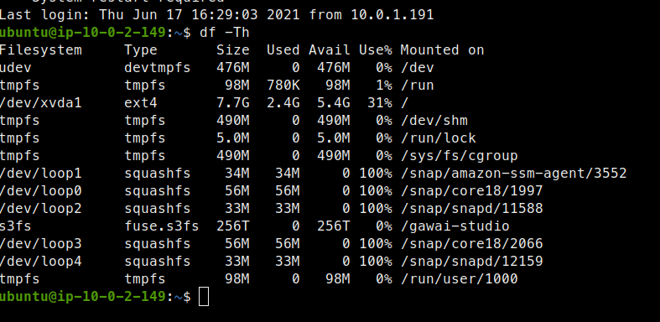
Berhasil Mounting S3

Slide 19
ROUTE 53

Slide 20
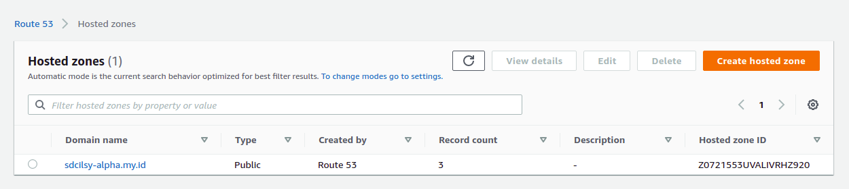
ROUTE 53

Slide 21
IAM ACCESS FINANCE

Slide 22
Terima kasih

Slide 23
AUTO SCALLING

Slide 24
Belum bisa dijalan kan pada saat ingin di create
issue nya bermasalah pada VPC

Slide 25
Terima kasih

